Slide 1
Machine Learning for data science and business intelligence – 8IAR403
By Kévin Bouchard Ph.D.
Professor in artificial intelligence & machine learning
Laboratoire d'Intelligence Ambiante pour la reconnaissance d'activités (LIARA)
Université du Québec à Chicoutimi
www.Kevin-Bouchard.ca

Slide 2

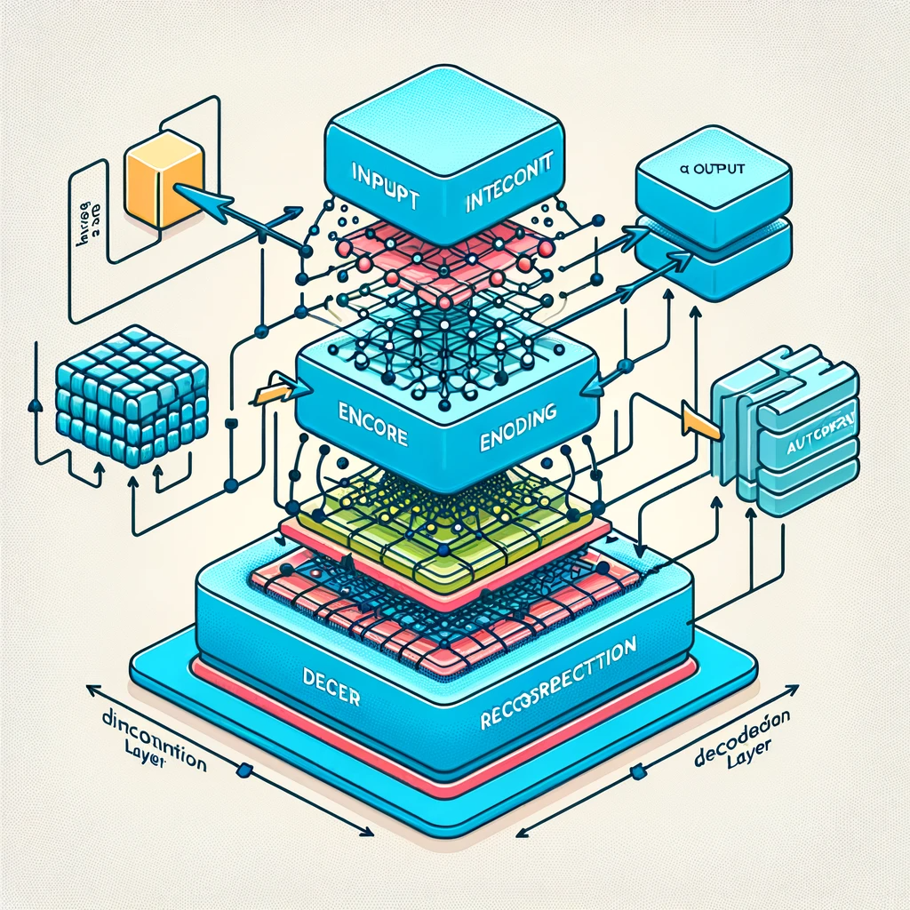
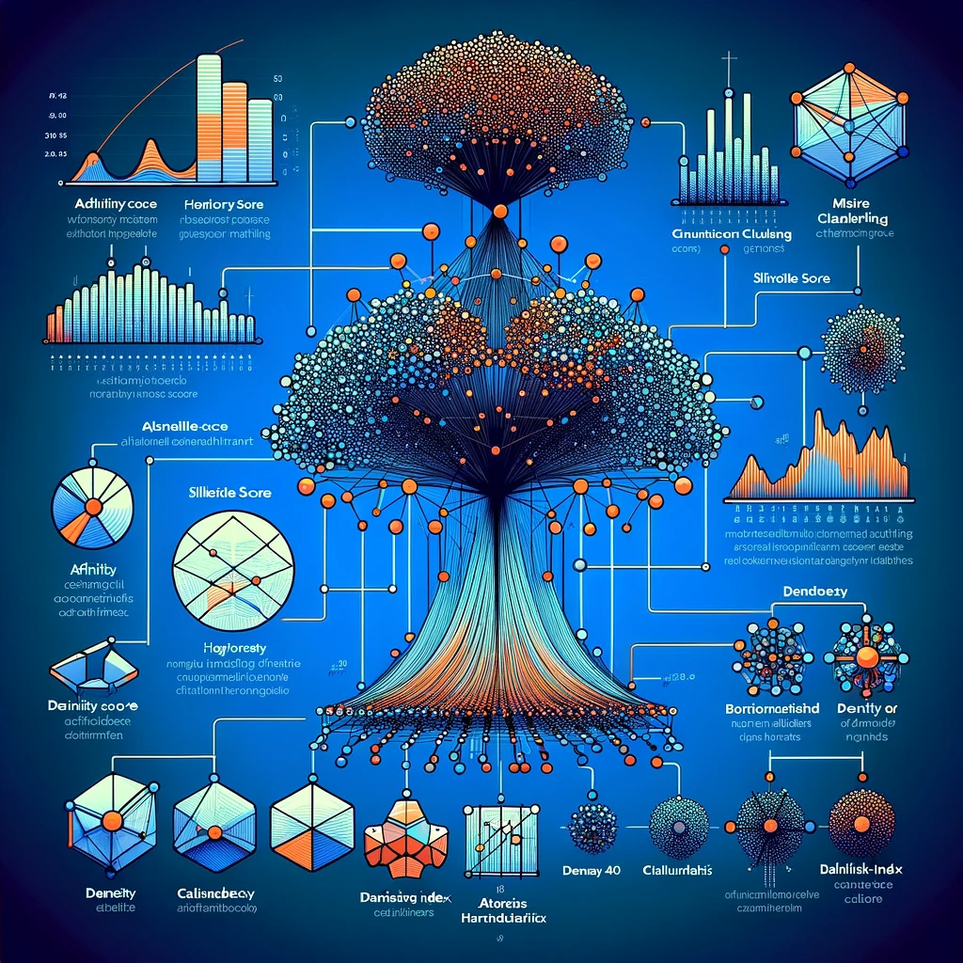

Summary of lesson #18
You will learn about:
Advanced methods for clustering including affinity, hierarchy, and density
A few metrics to evaluate your clusters

Slide 3
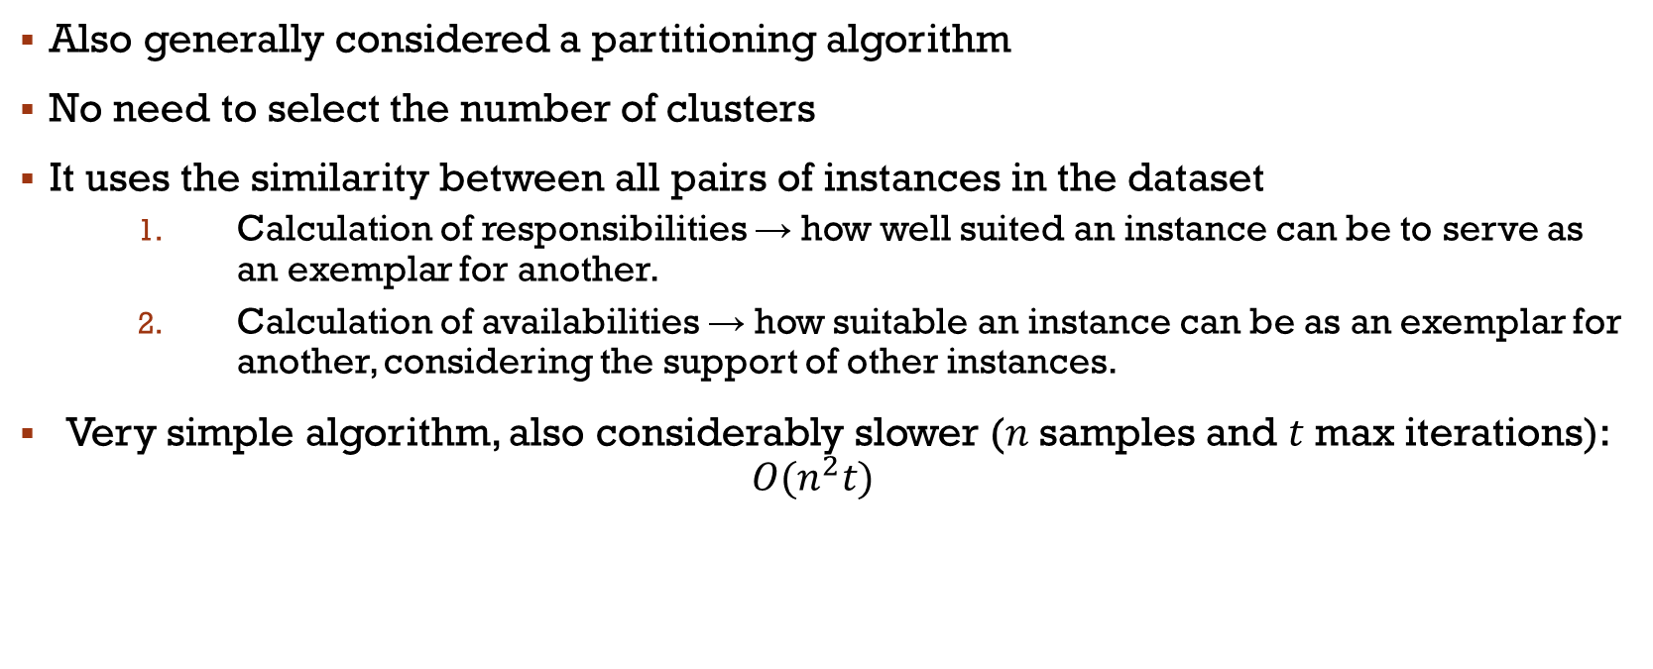
Affinity Propagation
Also generally considered a partitioning algorithm
No need to select the number of clusters
It uses the similarity between all pairs of instances in the dataset
Calculation of responsibilities → how well suited an instance can be to serve as an exemplar for another.
Calculation of availabilities → how suitable an instance can be as an exemplar for another, considering the support of other instances.
Very simple algorithm, also considerably slower ($n$samples and $t$max iterations):
$$O(n^{2}t)$$
Notes:
1 & 2 se base sur les valeurs précédentes
2 est à zéro au début
Stop avec un nombre max d’itérations ou un threshold
N-sample, t itérations->small to medium datasets

Slide 4
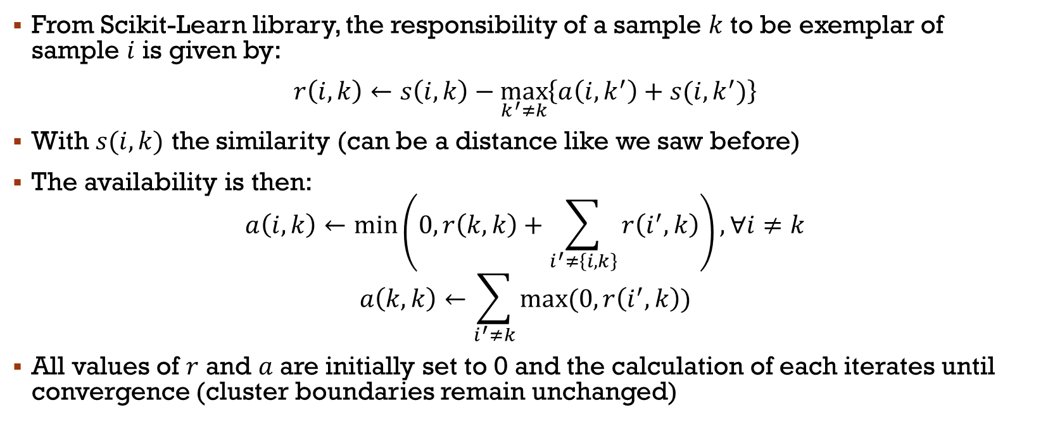
Affinity Propagation
From Scikit-Learn library, the responsibility of a sample $k$ to be exemplar of sample $i$ is given by:
$r\left(i, k\right)←s\left(i,k\right)−\max_{k^{′}≠k}\left\{a\left(i,k^{′}\right)+s(i,k^{′})\right\}$
With $s(i,k)$ the similarity (can be a distance like we saw before)
The availability is then:
$$a\left(i,k\right)←\min\left(0, r\left(k,k\right)+\sum_{i^{′}≠\left\{i, k\right\}}{r\left(i^{′},k\right)}\right), ∀i≠k$$
$$a\left(k,k\right)←\sum_{i^{′}≠k}{max⁡(0, r\left(i^{′},k\right))}$$
All values of $r$ and $a$ are initially set to 0 and the calculation of each iterates until convergence (cluster boundaries remain unchanged)
Notes:
1-all responsibility are computed
2-availability is updated

Slide 5
Hierarchy-based clustering
The basic idea of this kind of clustering algorithms is to construct the hierarchical relationship among data in order to cluster
Suppose that each data point stands for an individual cluster in the beginning, and then, the most neighboring two clusters are merged into a new cluster until there is only one cluster left
Or, a reverse process!
Scikit-Learn offers a generic class called AgglomerativeClustering to simulate the main methods and one more called BIRCH
However, there are several other:
Clustering Using REpresentatives (CURE), RObust Clustering using linKs (ROCK) are both implemented in pyclustering lib
DIvisive ANAlysis Clustering (DIANA), Chameleon

Slide 6
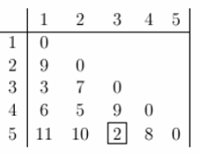
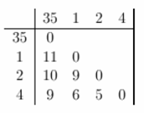
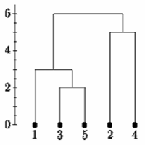
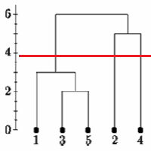
Agglomerative clustering
Agglomerative clustering builds clusters by merging individual samples step by step
This hierarchy of clusters is represented as a tree (or dendrogram)
The root of the tree is the unique cluster that gathers all the samples, the leaves being the clusters with only one sample
Look at this example using distances:
Where to cut?
Notes:
There is no commonly agreed-upon way to decide where to cut the tree.

Slide 7
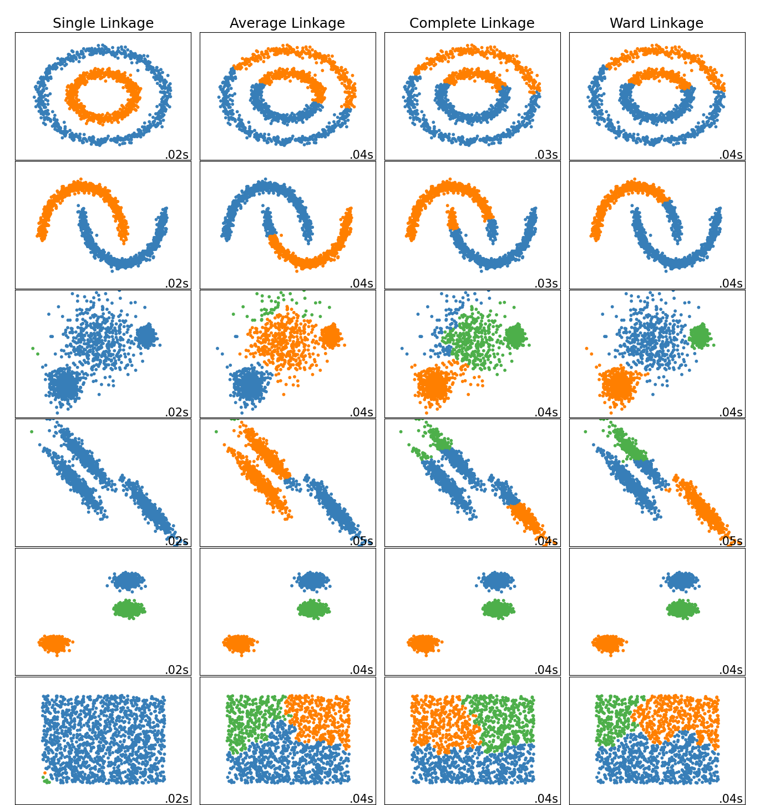

Hierarchical clustering
Ward minimizes the sum of squared differences within all clusters
Maximum or complete linkage minimizes the maximum distance between observations of pairs of clusters
Average linkage minimizes the average of the distances between all observations of pairs of clusters
Single linkage minimizes the distance between the closest observations of pairs of clusters
Notes:
Worst is single, usually ward is the best

Slide 8
Birch
BIRCH, which stands for Balanced Iterative Reducing and Clustering using Hierarchies, is an algorithm used for clustering large datasets, particularly those with a focus on spatial data
BIRCH realizes the clustering result by constructing the feature tree of clustering, CF tree, of which one node stands for a subcluster
CF tree will dynamically grow when a new data point comes
BIRCH is often used in scenarios where real-time data processing is required, and its incremental clustering nature makes it suitable for applications like environmental monitoring, market research analysis, and large-scale scientific data analysis

Slide 9
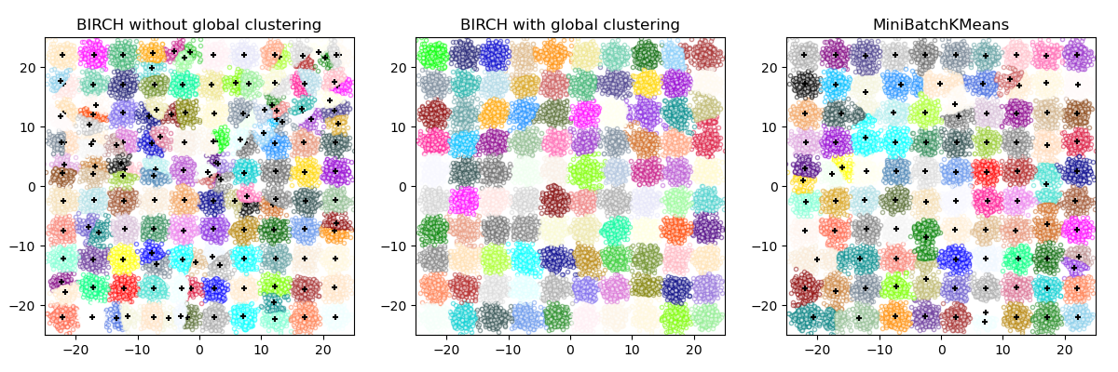
Birch
This example compares the timing of BIRCH (with and without the global clustering step) and MiniBatchKMeans on a synthetic dataset having 25,000 samples and 2 features generated using make_blobs
Both MiniBatchKMeans and BIRCH are very scalable algorithms and could run efficiently on hundreds of thousands or even millions of datapoints
Notes:
Global has a number of cluster set (like kmeans)

Slide 10
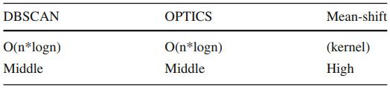
Density-based clustering
The basic idea of this kind of clustering algorithms is that the data which is in the region with high density of the data space is considered to belong to the same cluster
We’ll discuss Mean Shift, DBSCAN, and OPTICS
Advantages: clustering in high efficiency and suitable for data with arbitrary shape
Disadvantages:
resulting in a clustering result with low quality when the density of data space isn’t even
a memory with big size needed when the data volume is big
the clustering result highly sensitive to the parameters;

Slide 11
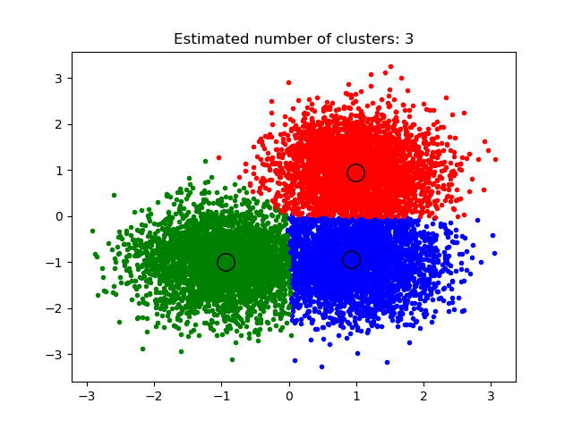
Mean Shift
MeanShift clustering aims to discover blobs in a smooth density of samples
It is a centroid based algorithm, which works by updating candidates for centroids to be the mean of the points within a given region
The position of centroid candidates is iteratively adjusted using a technique called hill climbing (local search), which finds local maxima of the estimated probability density
It is robust, doesn’t need a specified k and works with various cluster shapes
However, it is slow on large dataset, convergence may take longer if we had an unlucky start
Notes:
The algorithm is not highly scalable, as it requires multiple nearest neighbor searches during the execution of the algorithm. The algorithm is guaranteed to converge, however the algorithm will stop iterating when the change in centroids is small.

Slide 12
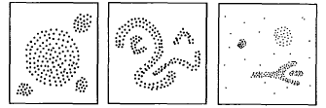
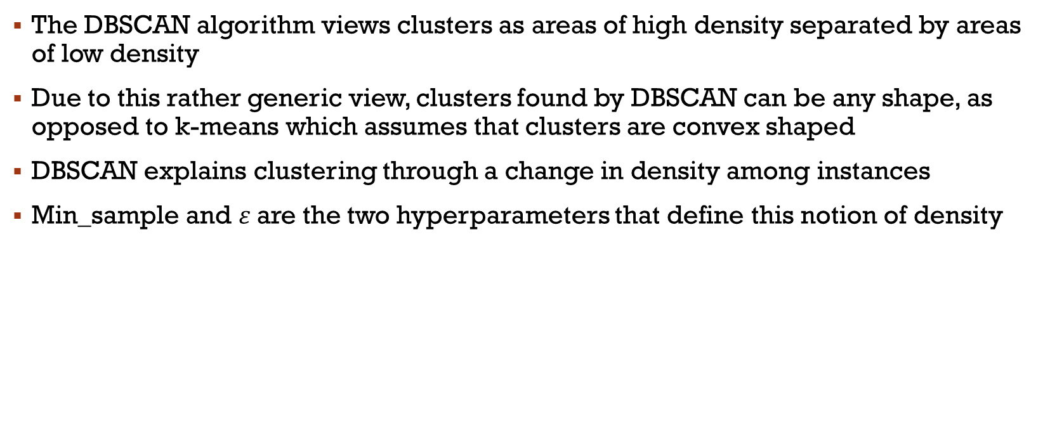
Density-Based Spatial Clustering of Applications with Noise (DBSCAN)
The DBSCAN algorithm views clusters as areas of high density separated by areas of low density
Due to this rather generic view, clusters found by DBSCAN can be any shape, as opposed to k-means which assumes that clusters are convex shaped
DBSCAN explains clustering through a change in density among instances
Min_sample and $ε$are the two hyperparameters that define this notion of density

Slide 13
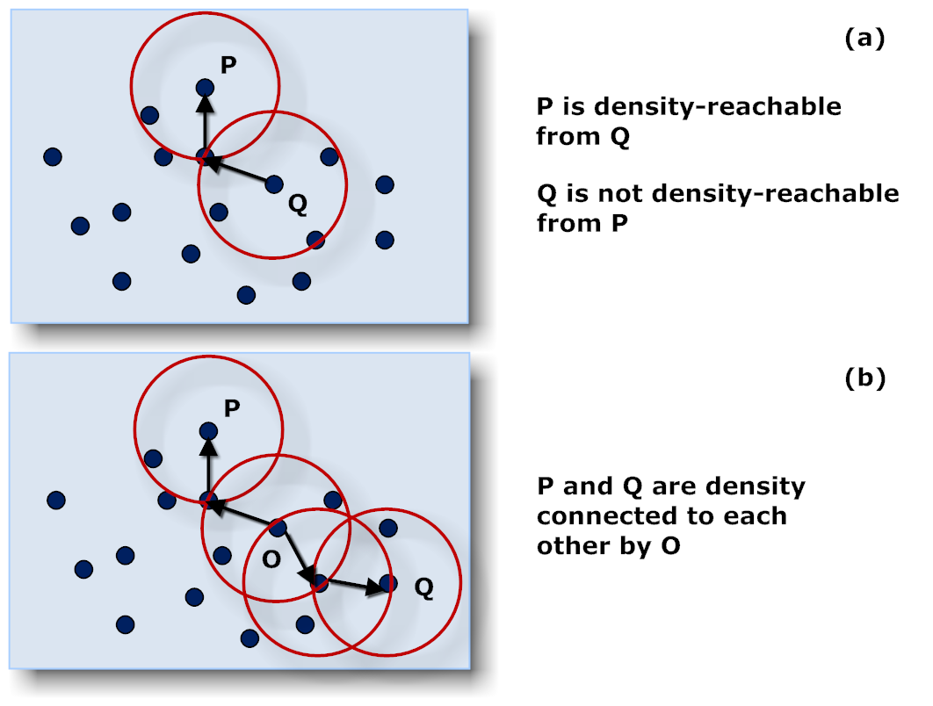
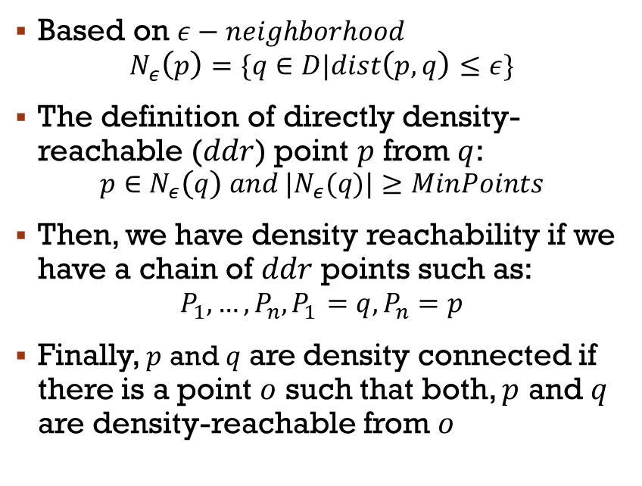
DBSCAN
Based on $ε−neighborhood$
$$N_{ε}\left(p\right)=\{q∈D|dist\left(p, q\right)≤ε\}$$
The definition of directly density-reachable ($ddr$) point $p$ from $q$:
$$p∈N_{ε}\left(q\right) and |N_{ε}(q)|≥MinPoints$$
Then, we have density reachability if we have a chain of $ddr$ points such as:
$$P_{1}, …, P_{n}, P_{1}=q, P_{n}=p$$
Finally, $p$ and $q$ are density connected if there is a point $o$ such that both, $p$ and $q$ are density-reachable from $o$
Notes:
Exercice?

Slide 14
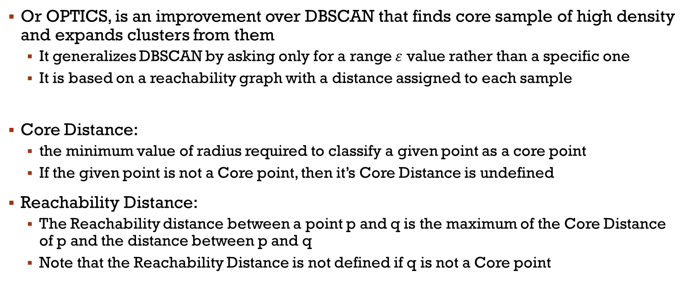
Ordering Points To identify the clustering structure
Or OPTICS, is an improvement over DBSCAN that finds core sample of high density and expands clusters from them
It generalizes DBSCAN by asking only for a range $ε$ value rather than a specific one
It is based on a reachability graph with a distance assigned to each sample
Core Distance:
the minimum value of radius required to classify a given point as a core point
If the given point is not a Core point, then it’s Core Distance is undefined
Reachability Distance:
The Reachability distance between a point p and q is the maximum of the Core Distance of p and the distance between p and q
Note that the Reachability Distance is not defined if q is not a Core point
Notes:
Prend beaucoup d’espace mémoire… ->OPTICS est mieux
OPTIC EST Un DBSCAN automatique (sans $ε$) Basé sur un graphe d’accessibilité

Slide 15
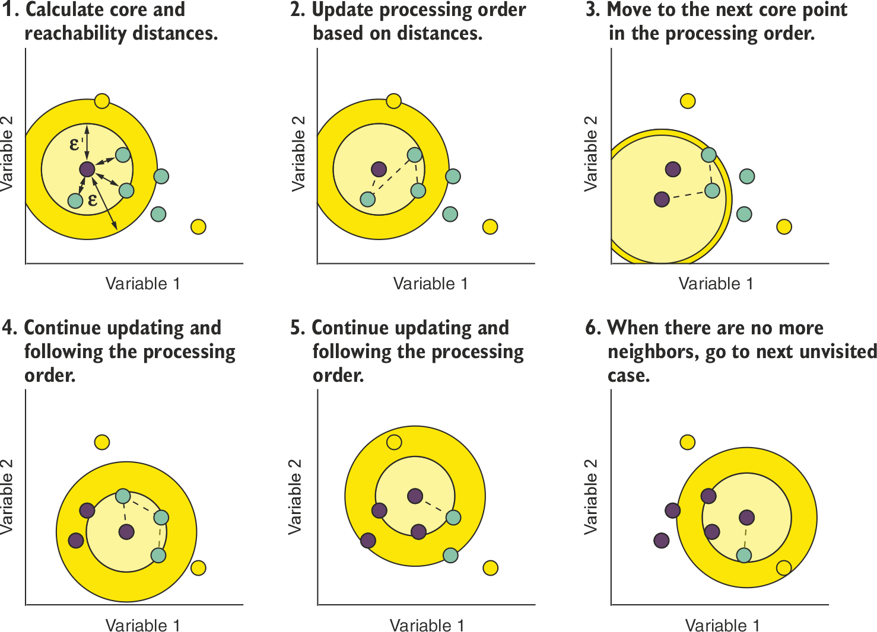
OPTICS
A case is selected, and its core distance (ϵ′) is measured
The reachability distance is calculated between this case and all the cases inside this case’s maximum search distance (ϵ)
The processing order of the dataset is updated such that the nearest case is visited next
The reachability score and the processing order are recorded for this case, and the algorithm moves on to the next one

Slide 16
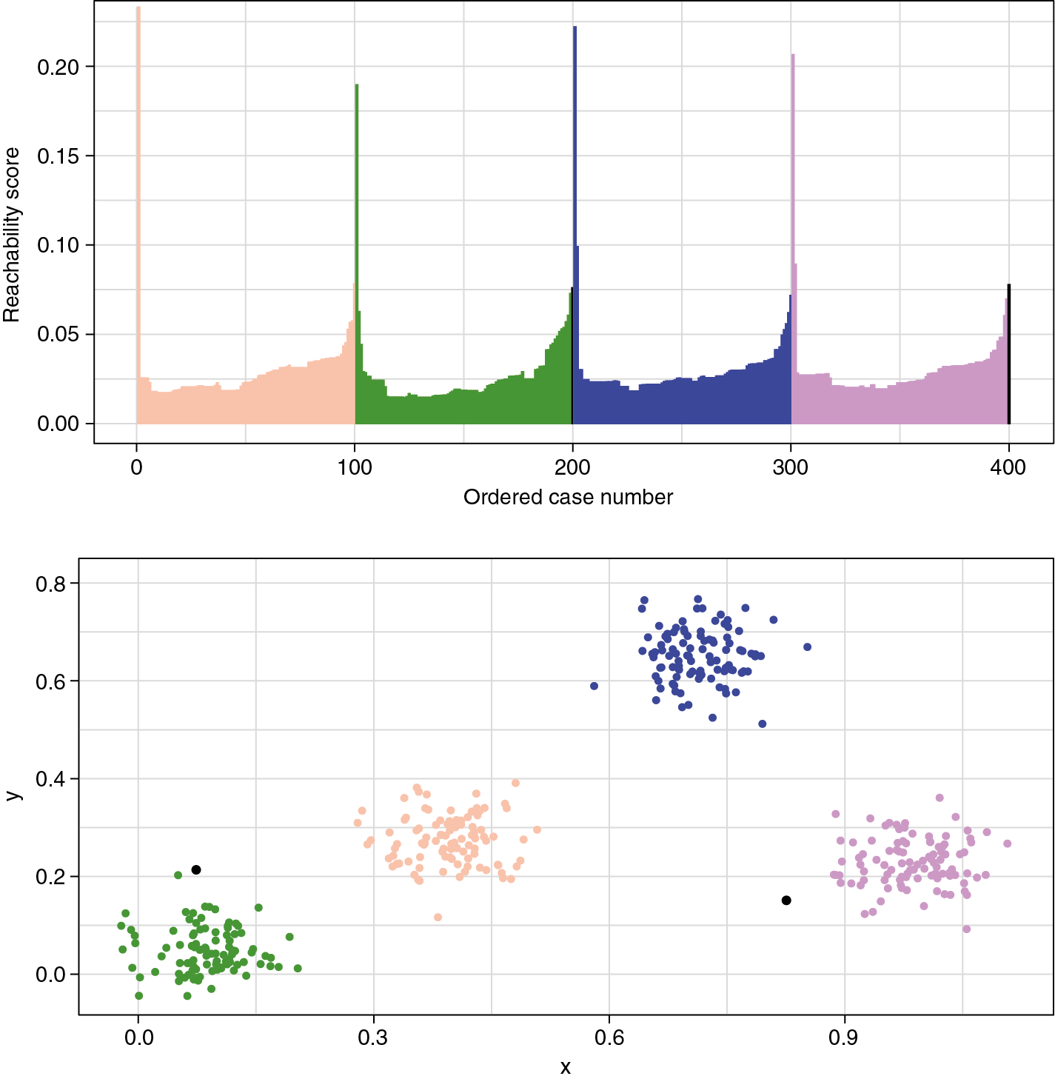
OPTICS
Reachability plot of a simulated dataset
The top plot shows the reachability plot learned by the OPTICS algorithm from the data shown in the bottom plot
The plots are shaded to indicate where each cluster in the feature space maps onto the reachability plot
Notes:
Check the example with them https://scikit-learn.org/stable/auto_examples/cluster/plot_optics.html

Slide 17
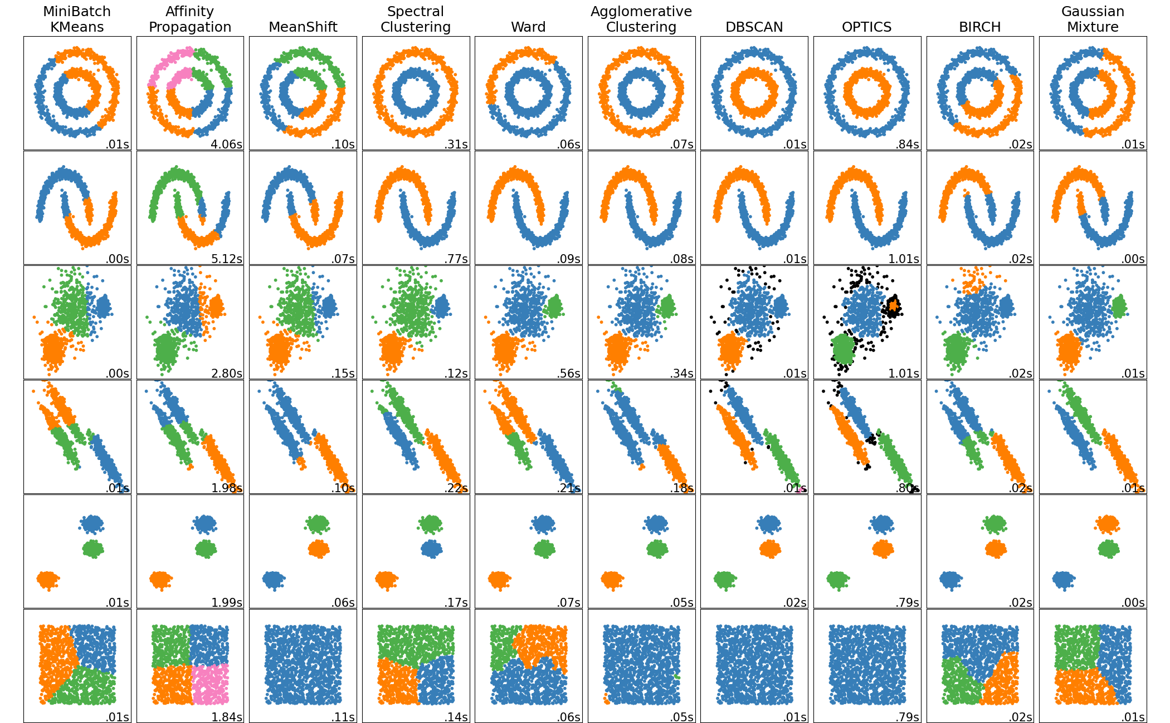
Notes:
Discuss a bit, time, noise, weird clusters

Slide 18
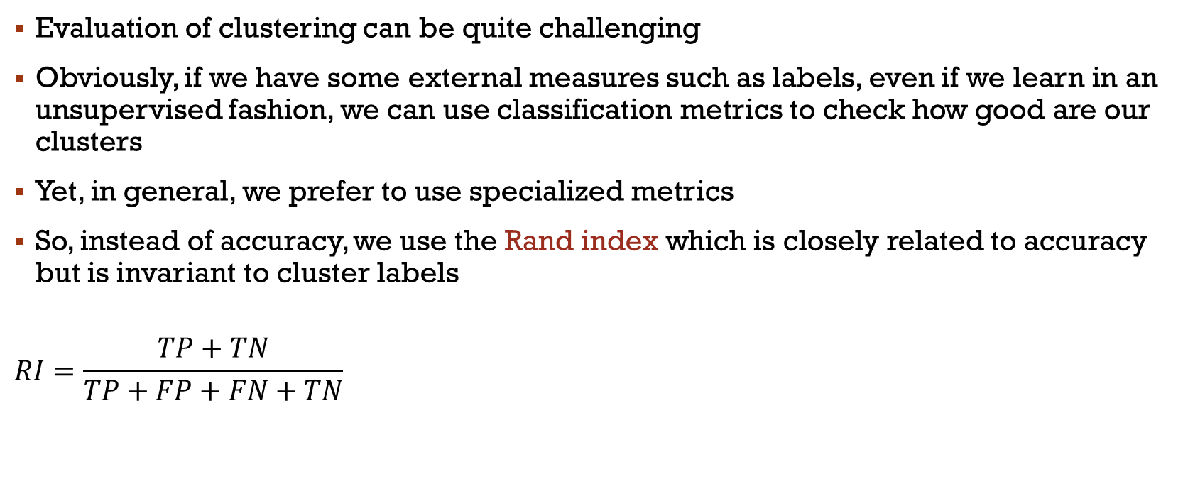
Evaluation metrics
Evaluation of clustering can be quite challenging
Obviously, if we have some external measures such as labels, even if we learn in an unsupervised fashion, we can use classification metrics to check how good are our clusters
Yet, in general, we prefer to use specialized metrics
So, instead of accuracy, we use the Rand index which is closely related to accuracy but is invariant to cluster labels
$$RI=\frac{TP+TN}{TP+FP+FN+TN}$$
True Positive: Same class + same cluster | False Negative: Same class + different cluster
False Positive: Different classes + same cluster | True Negative: Different classes + different cluster

Slide 19
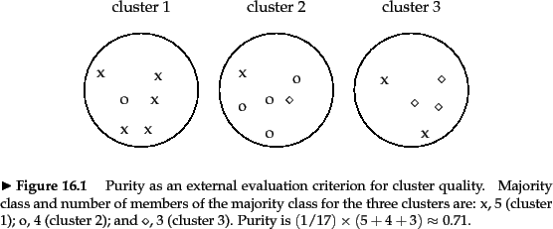
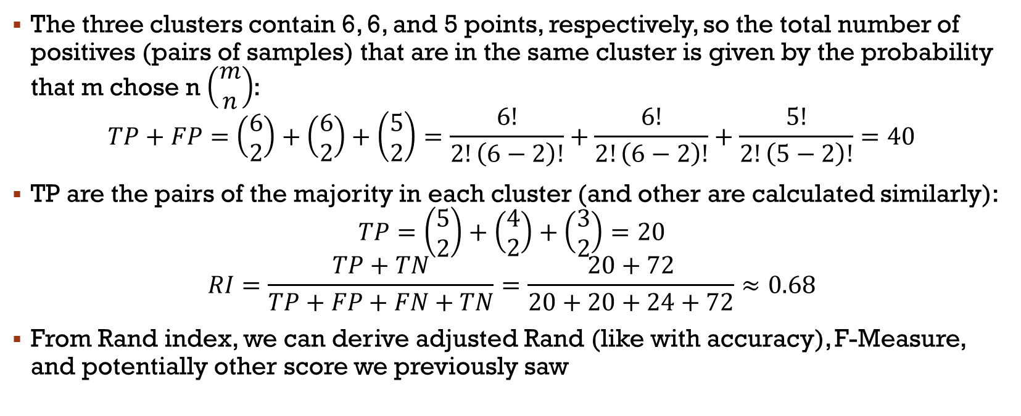
Rand Index
The three clusters contain 6, 6, and 5 points, respectively, so the total number of positives (pairs of samples) that are in the same cluster is given by the probability that m chose n $\left(\begin{matrix}m \\ n\end{matrix}\right)$:
$$TP+FP=\left(\begin{matrix}6 \\ 2\end{matrix}\right)+\left(\begin{matrix}6 \\ 2\end{matrix}\right)+\left(\begin{matrix}5 \\ 2\end{matrix}\right)=\frac{6!}{2!\left(6−2\right)!}+\frac{6!}{2!\left(6−2\right)!}+\frac{5!}{2!\left(5−2\right)!}=40$$
TP are the pairs of the majority in each cluster (and other are calculated similarly):
$$TP=\left(\begin{matrix}5 \\ 2\end{matrix}\right)+\left(\begin{matrix}4 \\ 2\end{matrix}\right)+\left(\begin{matrix}3 \\ 2\end{matrix}\right)=20$$
$$RI=\frac{TP+TN}{TP+FP+FN+TN}=\frac{20+72}{20+20+24+72}≈0.68$$
From Rand index, we can derive adjusted Rand (like with accuracy), F-Measure, and potentially other score we previously saw

Slide 20
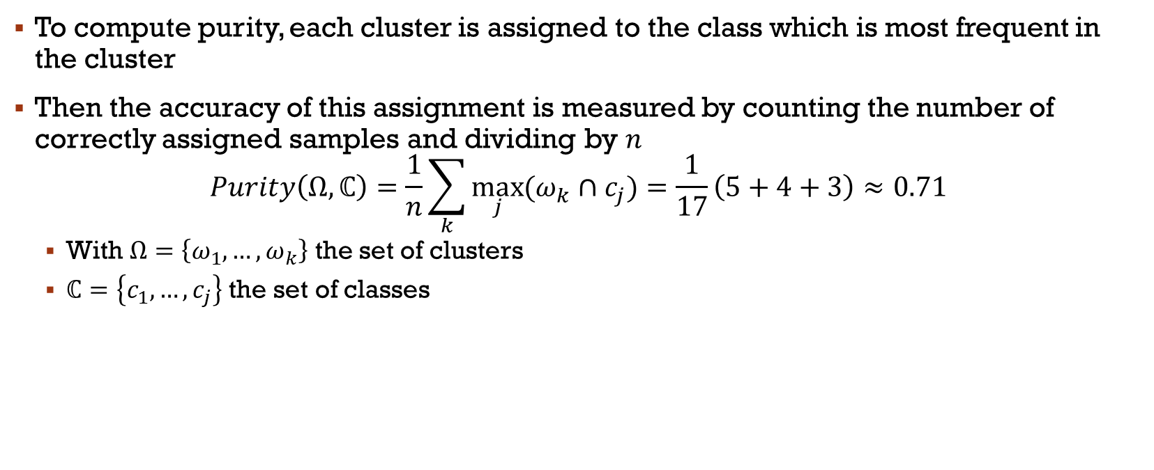
Purity
To compute purity, each cluster is assigned to the class which is most frequent in the cluster
Then the accuracy of this assignment is measured by counting the number of correctly assigned samples and dividing by $n$
$$Purity\left(Ω,ℂ\right)=\frac{1}{n}\sum_{k}{\max_{j}{(ω_{k}∩c_{j})}}=\frac{1}{17}\left(5+4+3\right)≈0.71$$
With $Ω=\left\{ω_{1},…,ω_{k}\right\}$ the set of clusters
$ℂ=\left\{c_{1},…,c_{j}\right\}$ the set of classes

Slide 21
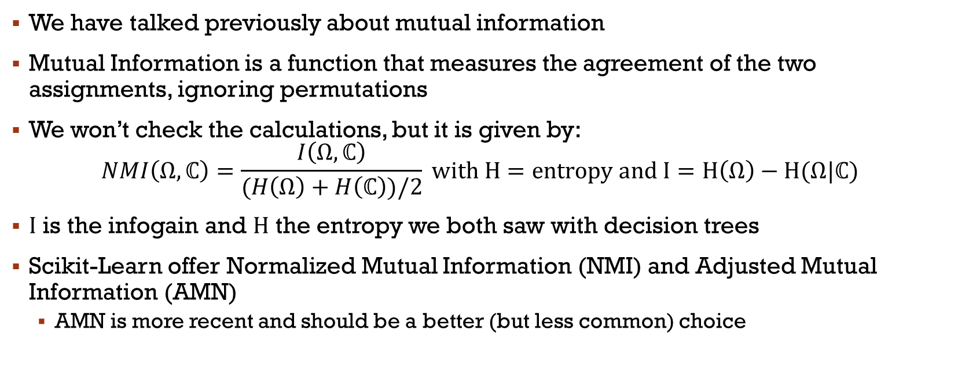
Mutual information
We have talked previously about mutual information
Mutual Information is a function that measures the agreement of the two assignments, ignoring permutations
We won’t check the calculations, but it is given by:
$$NMI\left(Ω,ℂ\right)=\frac{I\left(Ω,ℂ\right)}{(H\left(Ω\right)+H\left(ℂ\right))/2} with H=entropy and I=H\left(Ω\right)−H(Ω|ℂ)$$
$I$ is the infogain and $H$ the entropy we both saw with decision trees
Scikit-Learn offer Normalized Mutual Information (NMI) and Adjusted Mutual Information (AMN)
AMN is more recent and should be a better (but less common) choice

Slide 22
Without labels?
Obviously, we often don’t have the luxury of computing those measures with labels
There are, therefore, several other measures
Silhouette Score:
Measures how similar an object is to its own cluster compared to other clusters
The value ranges from -1 (incorrect clustering) to +1 (highly dense clustering).
Davies-Bouldin Index:
The average similarity between each cluster and its most similar one, where lower values mean better clustering

Slide 23
Without labels?
Calinski-Harabasz Index:
Also known as the Variance Ratio Criterion, it measures the dispersion between and within clusters
A higher score indicates better defined clusters
Dunn Index (not in Scikit-Learn):
Identifies sets of clusters that are well-separated by considering the ratio between the smallest inter-cluster distance to the largest intra-cluster distance
In addition to those, Scikit-Learn offers: V-measure, Contingency Matrix, and Pair Confusion Matrix

Slide 24
Main References
Russell S., Norvig P., Artificial Intelligence: A Modern Approach. Prentice-Hall, Englewood Cliffs, 2021.
Aggarwal, C. C., Neural networks and deep learning. Springer, 2023.
Goodfellow I., Bengio Y., Deep Learning. The MIT Press, 2016.
Raschka S., Python Machine Learning, Packt Publishing, 2015.
Sutton R.S., Barto A.G., Reinforcement Learning: An Introduction, A Bradford Book, 2021.
Witten I.H., Frank E., Hall M.A., Pal C. Data Mining: Practical Machine Learning Tools and Techniques, Morgan Kaufmann, 2016.

